Slide 1


HOW SHOULD WE FARM FOR A BETTER WORLD?
Lesson 8 - Can Schools Play a Role?

Slide 2
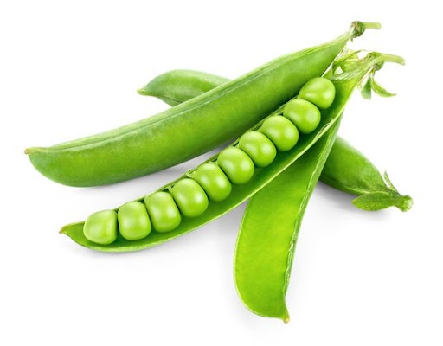
Learning Objectives
By the end of this lesson, you will be able to:
Evaluate whether schools can contribute to sustainable food systems
Apply scientific and practical knowledge to a real-world context
Identify benefits and challenges of school-based food growing
Take part in respectful debate and collective decision-making
Propose realistic solutions for managing a school growing project

Slide 3


Share the student videos
While watching, note:
One idea you found inspiring and one challenge raised.

Slide 4

Discussion Question:
Can schools play a role in growing food for a better world?
What does “a better world” mean in a school context?
Is the goal food production, education, wellbeing, or all three?
Does growing some food still matter if we can’t grow all food?
If the school already grows its own food, how might the system be improved?
School food growing can take many forms: Allotments, Raised beds, Containers, Polytunnels, Wall or vertical gardens
Even small-scale projects can have educational and environmental value

Slide 5
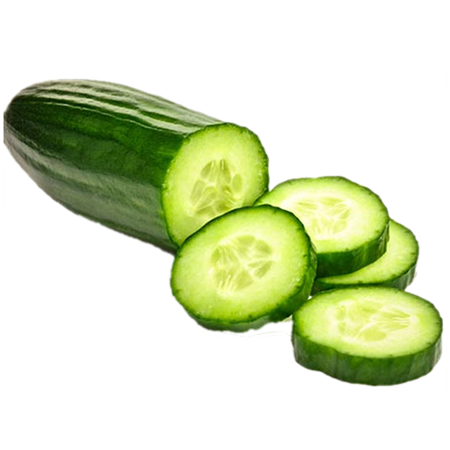
Design a realistic food-growing project for their school:
Consider and record:
1️⃣ Location - Playground edge, courtyard, wall, rooftop, containers, classroom windowsill
2️⃣ Scale - Small pilot project or whole-school initiative
3️⃣ Growing method - Soil beds, Containers, Vertical growing, Hydroponics
4️⃣ What to grow - Fruit, vegetables, herbs, pollinator plants
Crops chosen for season, ease, and educational value
5️⃣ Sustainability - Water use, Composting, Wildlife support, Organic or vegan organic approaches

Slide 6
Challenges and Solutions
Solutions include:
Gardening clubs
Community volunteers
Links with local community farms
Eco-School or Green Flag initiatives
Simple, low- maintenance crops
Rotas or partnerships
Key challenges:
Who looks after plants during holidays?
How is the project funded?
Who has time and knowledge?
What happens if crops fail?
Problem-solving is part of science - small steps still matter

Slide 7
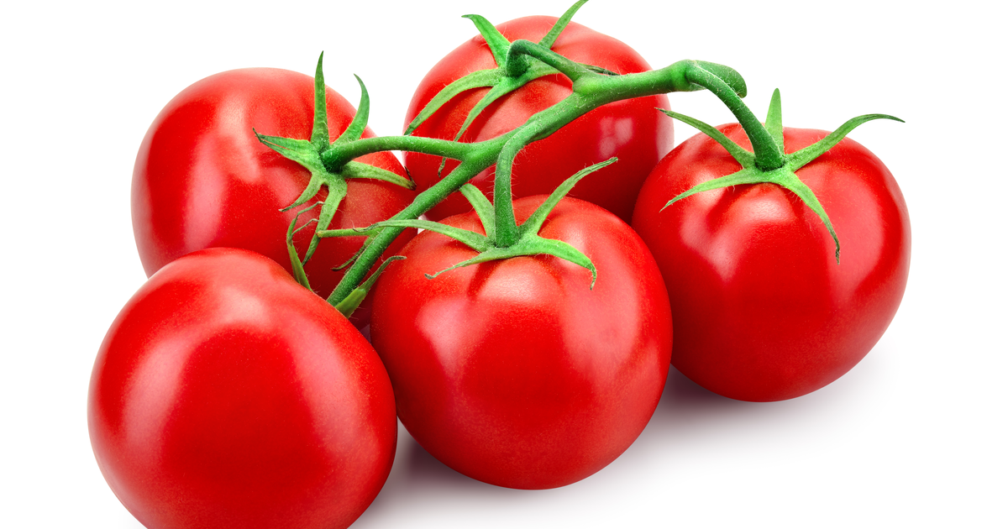
Mini Debate:
Should the school try to grow food? Why or why not? If already growing food, could the school change what they produce or increase/improve yield. Can better connections be made within the school and/or wider school community?
Would students support:
Containers only? Raised beds? A larger allotment? A pollinator garden alongside food? Hydroponic or vertical garden?
Exit Question:
What is one way schools could help create a better food future, even on a small scale?

Slide 8

Programme End Reflection
How has your view of farming changed?
What responsibilities do people have when producing food?
How can young people influence food systems?

