Slide 1


HOW SHOULD WE FARM FOR A BETTER WORLD?
Lesson 7 - How Can We Make Communicate these Ideas?

Slide 2
Learning Objectives
By the end of this lesson, you will be able to:
Explain how different farming methods affect people, animals, and the environment
Compare intensive, extensive, organic, vegan organic, community and high-tech farming approaches
Communicate scientific ideas clearly using digital media
Present balanced arguments using evidence
Work collaboratively to plan an engaging educational video

Slide 3

Discussion Questions:
Where do people get their information about food and farming?
Why might videos be more powerful than textbooks?

Slide 4

IMPORTANT
Use evidence from previous lessons
There's not always 'one right answer'
Be fair and balanced
Today’s Challenge
Create a 2-3 minute video answering:
"How Should We Farm for a Better World?"
Define 'A Better World'
Healthy ecosystems
Food security
Animal welfare
Climate stability
2. Include at Least Two Farming Approaches
Intensive/industrial farming (animal, crop, or both)
Extensive - organic/veganic farming
Extensive - community farming
Vertical or hydroponic farming
3. Pros and Cons
Present balanced arguments for each farming approach
4. Conclusion
End with a reflection or thought-provoking question

Slide 5
Planning your video - Group Activity
On your planning sheet identify:
Learning Objectives - what should the viewer take away?
Structure - Introduction (problem) / Middle (comparison) / Ending (reflection)
Bite-Sized Content - No long explanations - clear key messages only
Active Learning - Question for viewer / Pause to think / Poll or quiz idea
Real-World Examples - UK farms / School growing / Food choices
CLEAR
audio 🎤
Simple visuals 📊
Images over text 🖼️
Sound effects 🎵
Key: Accuracy over flashiness/ Respectful tone/ Positive but realistic

Slide 6
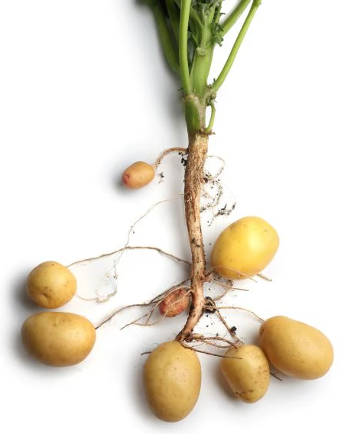
Share your ideas:
Your video title
One farming method they will include
One challenge they will address

Slide 7

Exit question:
What does “farming for a better world” mean to you now?
Videos will be completed as homework or next lesson
They will be shared for debate and decision-making

