Slide 1


HOW SHOULD WE FARM FOR A BETTER WORLD?
Lesson 6 - Can community farms feed people?

Slide 2
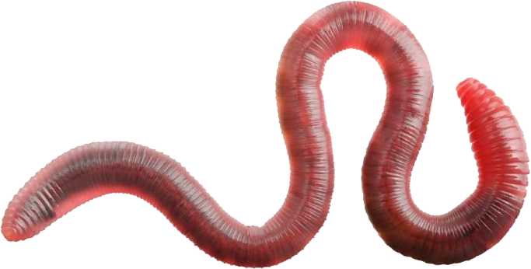
Learning Objectives
By the end of this lesson, you will be able to:
Evaluate whether community farms can feed local populations
Explain how population density, diet, and land use affect food supply
Identify limitations of community farming in the UK
Describe how hydroponics and vertical farming could increase food production
Suggest realistic adaptations to improve food security

Slide 3

Quick Recap:
What is a community farm?
What food do they grow?
Can community farms realistically produce enough food for all local people?
Vote: Yes, No or Maybe (and give a reason)

Slide 4
Limits of Community Farming
Community farms focus on:
Fruit and vegetables
Some raise livestock
Mixed farms
Usually:
Use smaller areas of land
Prioritise sustainability & education over profit
Key limitation:
Even very productive community farms usually cannot supply enough food for everyone in towns or cities.

Slide 5
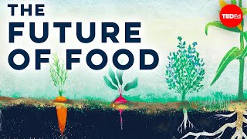

Can We Create the 'Perfect' Farm?
While watching, identify: one challenge with current food systems and one idea for improving food production

Slide 6

Can Community Farms Feed Local Populations?
In less-dense population areas community-scale farming can sometimes:
Feed local people
Be more self-sufficient
In the UK we have almost 70m people and
limited land.
Most land is used for:
Animal farming
Animal feed crops
The UK could theoretically support food needs IF:
Diets shift towards more plant-based foods
Efficient land use - growing crops for humans, not raising animals
We reduced food waste

Slide 7
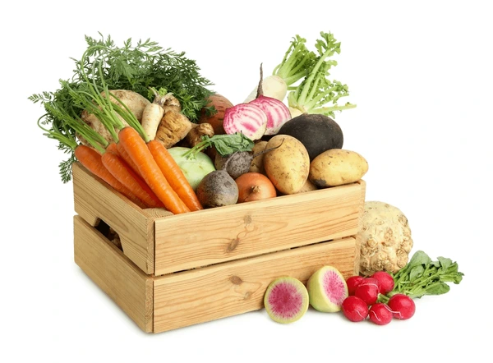
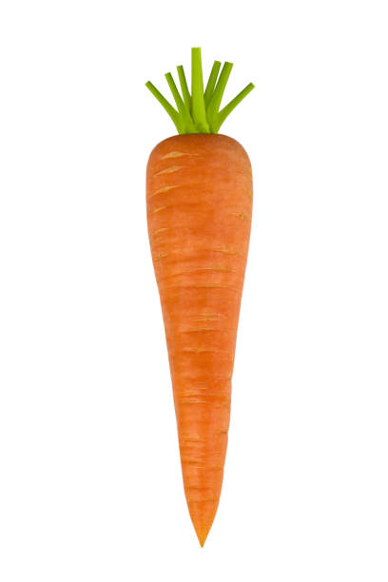
Think, pair, share…
If land is limited, how else could food production increase?

Slide 8
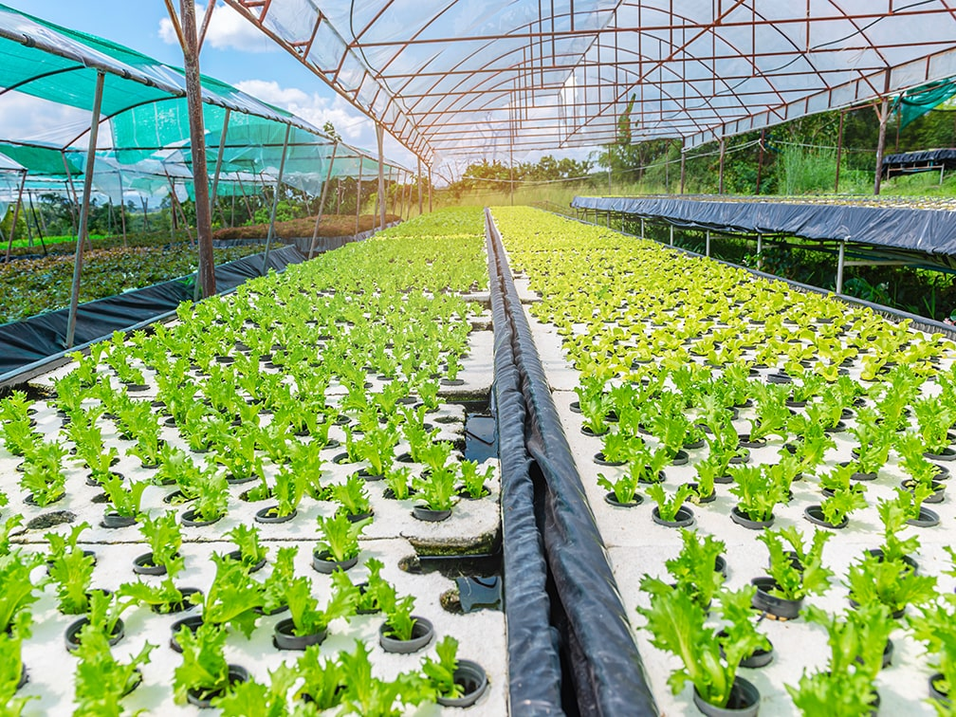
Farming Adaptations: Hydroponics
Hydroponics is growing plants without soil, the nutrients delivered through water
Advantages:
Uses less space
Uses less water
Faster growth
Year-round production

Slide 9
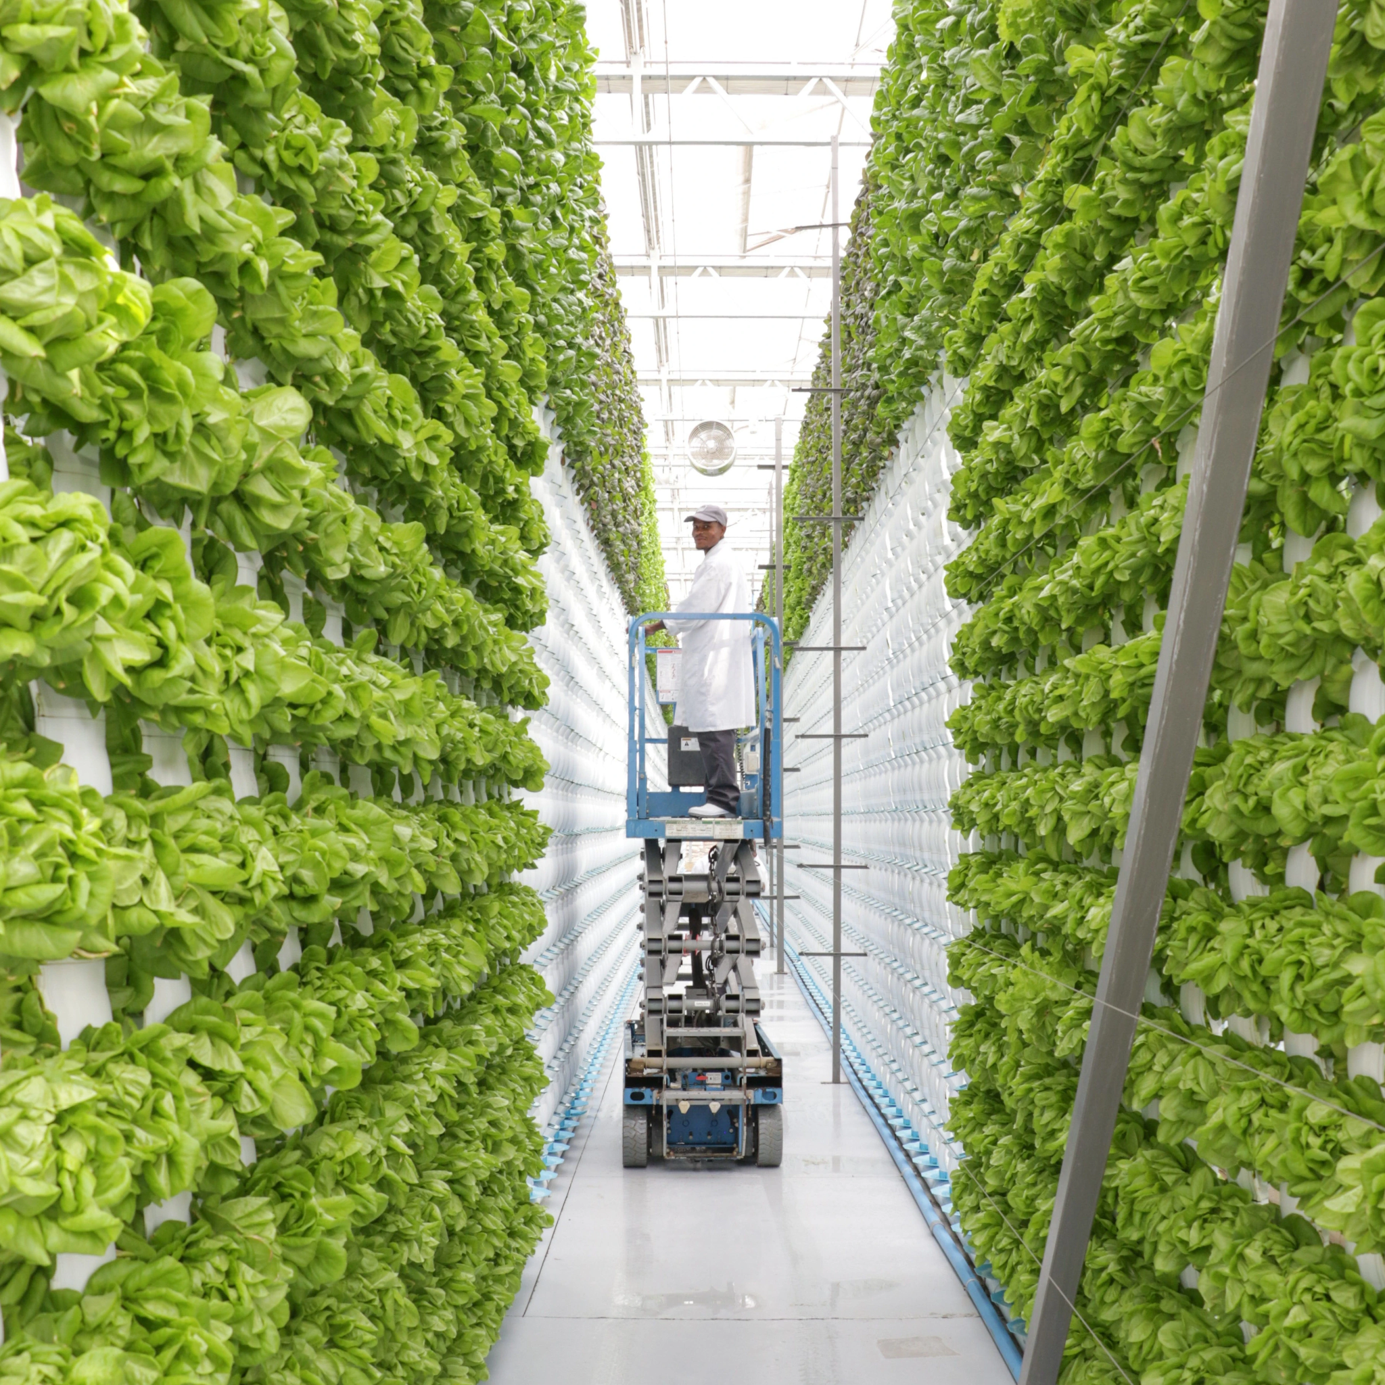
Farming Adaptations: Vertical Farming
Vertical Farming is growing crops in stacked layers, often indoors
Advantages:
Maximises production in small areas
Can be used in cities
Controlled environment
Less affected by weather

Slide 10
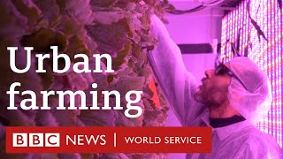
Farming Indoors
While watching, identify: one advantage of indoor vertical farming and one limitation

Slide 11

Designing a Food System Solution
RHS Challenge - Choose one option:
Option A - Hydroponic Garden
Where would it be used?
(school, city, warehouse?)
What crops would be grown?
How does it save space?
Option B - Vertical Garden
What materials could be reused?
Where could it be built?
Who could benefit from the food grown?

Slide 12
On your tables sort and rank the following 8 statements (with the one you are most willing to do at the top):
Reduce meat consumption - shift toward a more plant-based diet
Reduce food waste - plan meal, store food well and use leftovers
Adopt a vegan diet - Eliminate all animal products
Support regenerative/ organic farms - choose sustainable products
Join or support community farms - engage with local food production
Buy seasonal, local fruit and veg - no strawberries in January!
Grow your own food at home to supplement your diet
Change nothing

Slide 13
Can community farms alone feed local people, or must they be part of a wider food system?
Explain your answer using evidence from the lesson.
Consider:
Population size
Land use
Diet
Technology
Challenge: What do the terms sustainable food production and food security mean?

Slide 14
Further Opportunities / Project-Based Learning:
Link plant growing to: Photosynthesis, Nutrients, Water transport
Explore: Pollinators and outdoor farming limits, Energy use in indoor farming
Run an extended project: School hydroponic or vertical growing trial

