Slide 1


HOW SHOULD WE FARM FOR A BETTER WORLD?
Lesson 5 - What Are Community Farms?

Slide 2
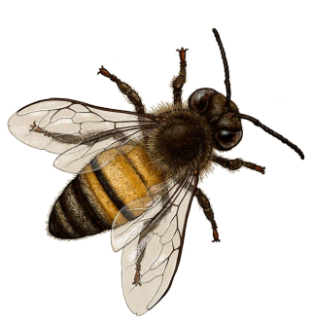
Learning Objectives
By the end of this lesson, you will be able to:
Describe what a community farm is and how it operates
Identify typical sizes and structures of community farms in the UK
Recognise shared principles of community farming globally
Explain benefits and challenges of community-led food production
Design a simple plan for a local community farm

Slide 3

Think, Pair, Share…
What does the word "community" mean?
How might it change the way a farm works?

Slide 4

What Are Community Farms?
Key Characteristics:
People work together to:
Grow crops
Sometimes raise animals
Support local food systems
Usually small-medium scale owned/ managed by:
Local groups
Charities
Cooperatives
Shared agricultural spaces where people work together for the greater good!

Slide 5
Core Values of Community Farms
Environmental responsibility - caring for land and ecosystems
Food Access and Fairness - making healthy food available locally
People, animals and planet above financial profit
Education and Skills Sharing - learning and teaching together
Social Connection - building strong communities
Ethical Concern for Animals - respecting animal welfare

Slide 6
Typical Sizes of Community Farms
20 to 100+ acres
Rare - often historic land protected by communities
5 to 20 acres
Mixed horticulture, orchards, small livestock
1 to 5 acres
Market gardens: urban/peri-urban farms at the edge of cites
An acre is a land area of around 4000m²

Slide 7
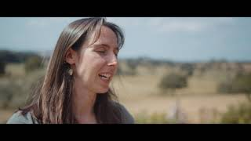

Video 1 - Fordhall Organic Farm, North Shropshire, England
Whilst watching note the size of the farm, one activity the farm does and one way the community is involved

Slide 8
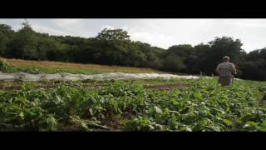
Video 2 - Northeast London, Cooperative, Vegan organic growing
Whilst watching note the size of the farm, one activity the farm does and one way the community is involved

Slide 9

Video 3 - Sadhana Forest, India
Whilst watching note the size of the farm, one activity the farm does and one way the community is involved

Slide 10
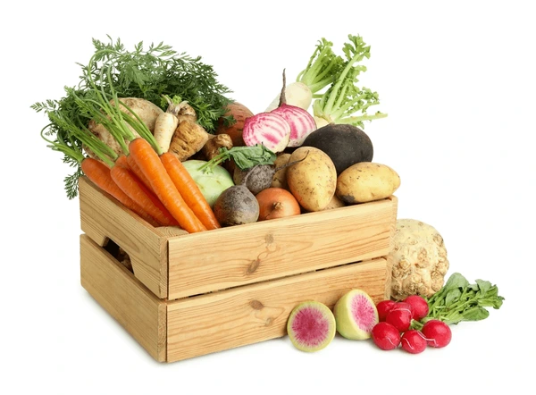
In pairs list:
✓ 3 benefits of community farms
✗ 3 challenges they might face

Slide 11
Check:
Common benefits may include:
✔ Fresh local food
✔ Education and skills
✔ Stronger communities
✔ Environmental care
Common challenges may include:
✖ Funding
✖ Access to land
✖ Labour and time
✖ Resource management

Slide 12
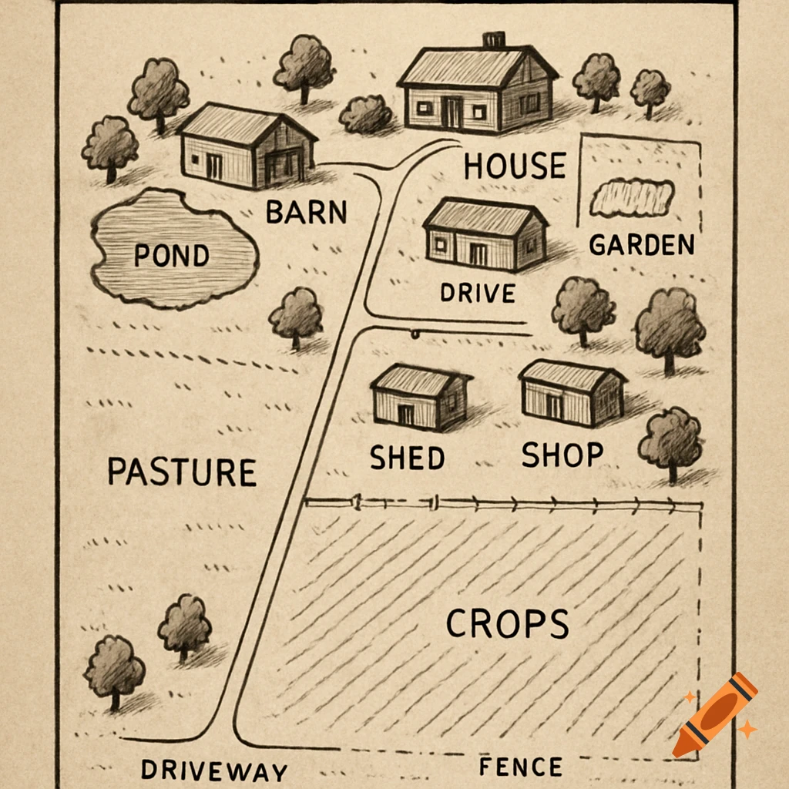
Design a Community Farm near our school:
Consider:
Where would it be located?
How much land would it use?
How would it support nature and biodiversity?
Would it keep animals? If so, which and why?
What crops or foods would it grow and why?
What skills and knowledge would be needed?
Where could help or training come from?
What benefits would it bring to local people?

Slide 13
Quick Quiz
What is a community farm?
A large commercial farm owned by a corporation
A farm that only grows one type of crop
A shared agricultural space where people work together to grow food
A farm run entirely by the government

Slide 14
2. Which of these is NOT typically a core value of community farms?
Environmental responsibility
Maximizing profit above all else
Education and skills sharing
Social connection

Slide 15
3. What is the typical size range for most UK community farms?
Less than 1 acre
1-20 acres
100-500 acres
Over 1000 acres

Slide 16
4. Which of these is a benefit of community farms?
Fresh local food
Education and skills development
Stronger communities
All of the above

Slide 17
5. Name ONE challenge that community farms face:

Slide 18
ANSWERS:
1. C
2. B
3. B
4. D
5. Possible answers include: Funding, Access to land, Labour and time, Resource management (equipment and materials)

Slide 19
Extension / Homework
Options:
Research local community farms
Write a paragraph answering “Why are community farms important?”
Draw and label a plan for a community farm

