Slide 1


HOW SHOULD WE FARM FOR A BETTER WORLD?
Lesson 4 - Is Nature-Friendly Farming
the Future?

Slide 2
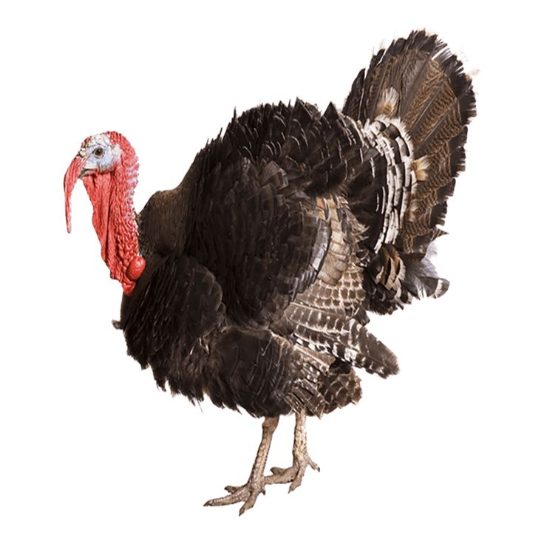
Learning Objectives
By the end of this lesson, you will be able to:
Explain what organic farming and vegan organic farming are
Describe what fertilisers and pesticides do
Compare natural and synthetic fertilisers and pesticides
Identify chemicals used in animal farming and their impacts
Compare organic, vegan organic, and intensive farming systems

Slide 3

Round-robin
How do farmers help crops grow and protect them from pests?
1. Write two ideas
2. Take turns to share on your table

Slide 4
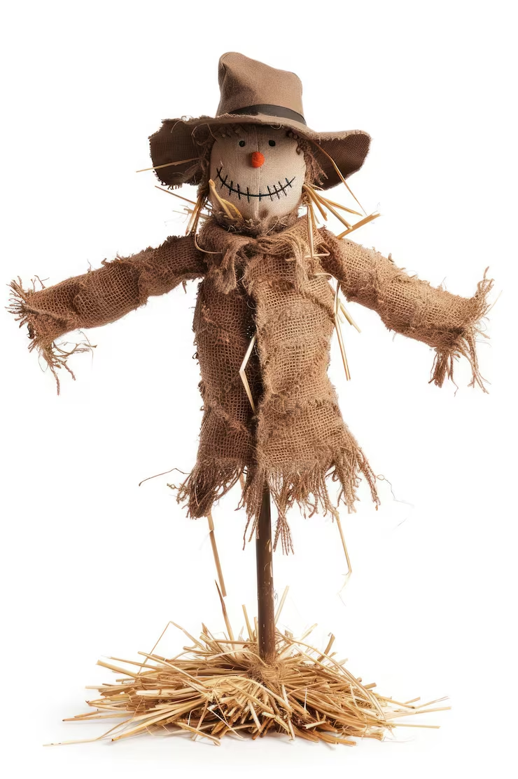
Modern agriculture doesn’t just use scarecrows it uses agrochemicals!
Agrochemicals include:
Pesticides (to kill pests)
Insecticide (to kill insects)
Herbicides (to kill unwanted plants)
Fungicides (to kill fungi and mould)
Fertilisers (to boost plant growth)
Can you think of any problems these might cause?
Farmers can also use natural products or
electronic pest repellents.

Slide 5
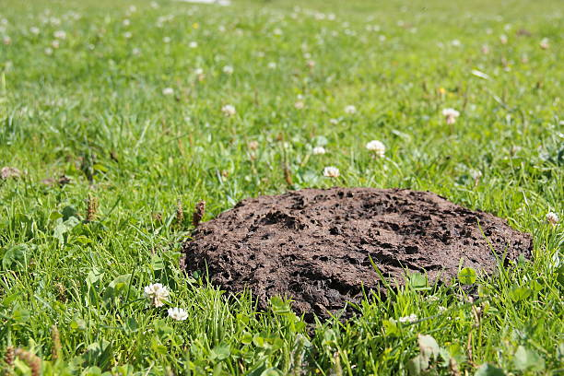
What is Organic Farming?
Key Characteristics:
Uses natural fertilisers (manure, compost)
Avoids most synthetic chemicals
Uses natural pest control
Encourages biodiversity
May still use animal by-products
often overlaps with permaculture and
regenerative farming
Includes farmed animals and uses animal by-products
Permaculture, or permanent agriculture, is a farming system that mimics the patterns, relationships, and resilience found in natural ecosystems to create sustainable, self-sufficient, and productive agriculture.

Slide 6
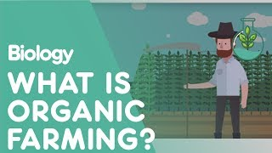

Slide 7
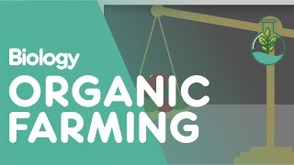

Slide 8
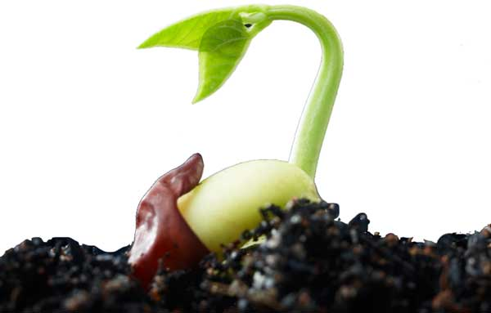
What is Vegan Organic Farming?
Key Characteristics:
No farmed animals in the system
Uses plant-based compost & green manures
Crop rotation for soil health
Aligns with permaculture and regenerative farming
No animal manure, bone meal, or animal inputs
Focuses on soil health, biodiversity & ethics
Encourages wildlife (not farmed animals)
No farmed animals, plant-based only

Slide 9
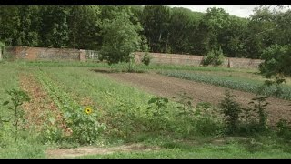

Slide 10
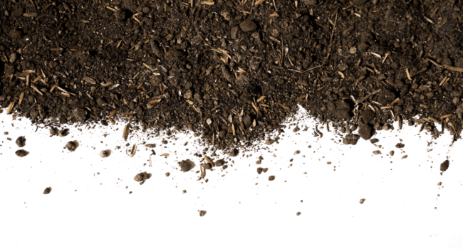
What is a Fertiliser?
A substance added to soil to:
Help plants grow
Replace nutrients plants remove from the soil
Crops use nutrients as they grow. Without fertiliser, soil can become poor over time.
The main nutrients are the elements Nitrogen (N), Phosphorus (P) and Potassium (K) so fertilisers usually state the values of NPK.

Slide 11
Natural vs Synthetic Fertilisers
Natural Fertilisers
e.g., green manure, compost, animal manure, bone meal, fish meal
Pros:
Improve soil structure
Support soil life
Lower pollution risk
Cons:
Slower nutrient release
Can still cause pollution if misused
Synthetic Fertilisers
Made in factories with concentrated chemicals
Pros:
Fast plant growth
Easy to measure
Cons:
Can damage soil
Water pollution
High carbon impact (leading to global warming)

Slide 12
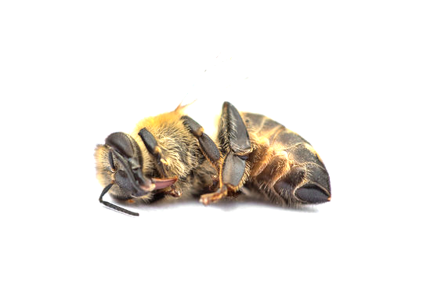
What are Pesticides?
Pesticides are substances used to:
Kill or control insects, weeds, or fungi
Protect crops from pests and diseases
Increase yield
Natural Pest Control
Examples: Companion planting, encouraging predators (ladybirds), plant-based sprays
Pros:
Safer for wildlife
Less pollution
Cons:
Slower action
Not always fully effective
Chemical Pesticides
Synthetic sprays and chemicals
Pros:
Very effective
Fast results
Cons:
Harm insects (including bees)
Can affect human & animal health
Pollute soil and water

Slide 13
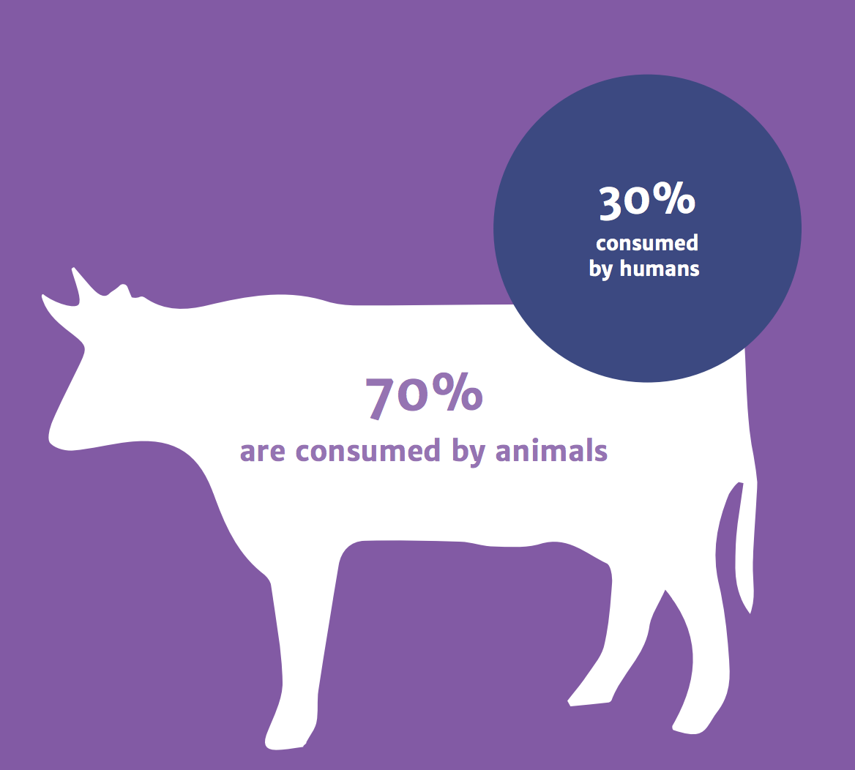
Chemicals in Animal Production
Examples include: antibiotics, growth hormones, wormers and disinfectants
Pros:
Prevent disease in crowded conditions
Increase food production
Cons:
Antibiotic resistance
Pollution from waste
Animal welfare concerns
Chemicals enter soil & water through manure
Can affect animal & human health
Antibiotics

Slide 14


Slide 15
Summary of the types of Farming Systems
INTENSIVE FARMING
EXTENSIVE FARMING
🌾Farming of Crops
Selective breeding of crops
Synthetic fertilisers & pesticides
Manure/slurry from factory farms
Monoculture cropping
High yields
High environmental impact
🐄Farming of Animals
Large-scale animal confinement
Selective breeding of animals
Routine antibiotics & medicines
Overcrowded fish farms
High yields
High environmental impact
🍃Organic Farming
Natural fertilisers & pesticides
Better animal welfare (if raising animals)
Uses animal manure & by-products
Fewer chemicals
Emphasis on sustainability
Low environmental impact
🌱Vegan Organic Farming
Plant-based fertilisers only
No confined animals or animal by-products
Focus on soil health & ecosystems
Emphasis on sustainability & biodiversity
Low environmental impact

Slide 16
Exit Question
Using the information on the previous slide answer one of these questions.
Which farming system do you think is most sustainable? Why?
Or:
Name one benefit and one drawback of using chemicals in farming.
In your answer, try to use the following keywords:
Pesticides
Nutrients
Antibiotics
Yields

Slide 17
Extension / Homework
Options:
Create a comparison table of the different farming methods
Write a paragraph answering: “Should farming rely less on chemicals? Explain.”
Research plant-based fertilisers and write a paragraph answering: “What are nitrogen fixing plants and why use them over nitrogen fertiliser?”
Write a short news story on the impact of animal manure from UK factory farms on the environment.

