Slide 1


HOW SHOULD WE FARM FOR A BETTER WORLD?
Lesson 3 - Soil, Crops and Biodiversity

Slide 2
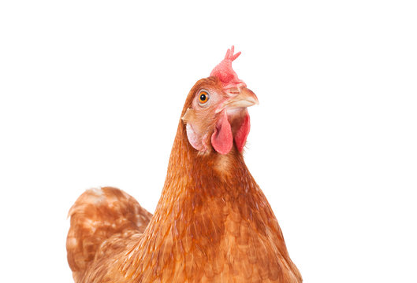
Learning Objectives
By the end of this lesson, you will be able to:
Explain why soil is essential for life on Earth
Identify different types of crops and their uses
Describe what biodiversity is and why it matters
Explain how plant and animal agriculture affect habitats and wildlife
Evaluate whether farming choices can help protect biodiversity and reduce climate change

Slide 3

Think, Pair, Share
What do plants, animals, and humans all depend on to survive?
1. Write one idea
2. Pair up with a partner
3. Share on your table

Slide 4
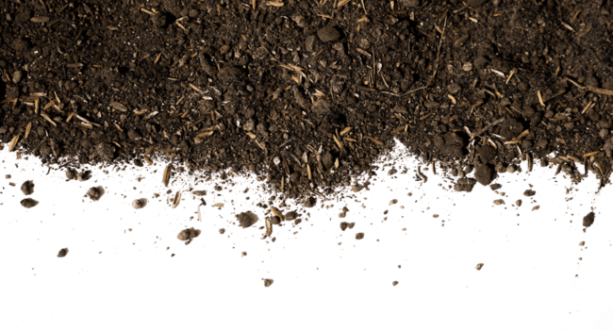
Section A: Soil – The Foundation of Life
What is Soil?
Soil is made of minerals, air, water, and living organisms
It supports plant growth and stores carbon
Healthy soil supports food production and biodiversity

Slide 5
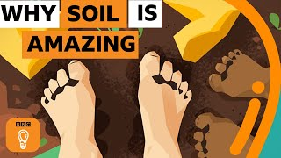

Slide 6
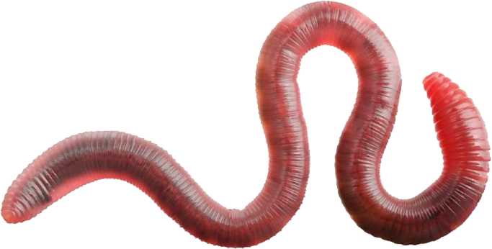
Why Soil Matters
Supports Life
Home to 25% of Earth's biodiversity - billions of organisms in one handful
Grows Food
95% of our food comes from soil - essential for agriculture
Stores Carbon
Contains more carbon than all plants and atmosphere combined
What might happen if soil becomes damaged or unhealthy?

Slide 7
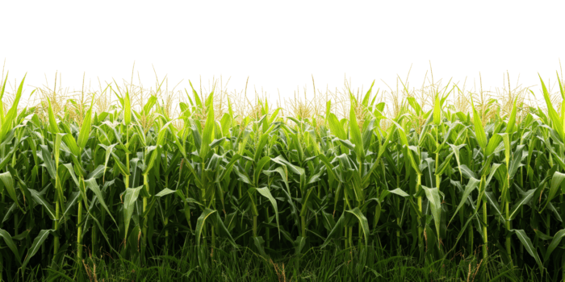
Section B: Crops – What We Grow and Why
What is a Crop?
Food to eat
Materials for clothing fuels and building
Income, selling produce for profit

Slide 8
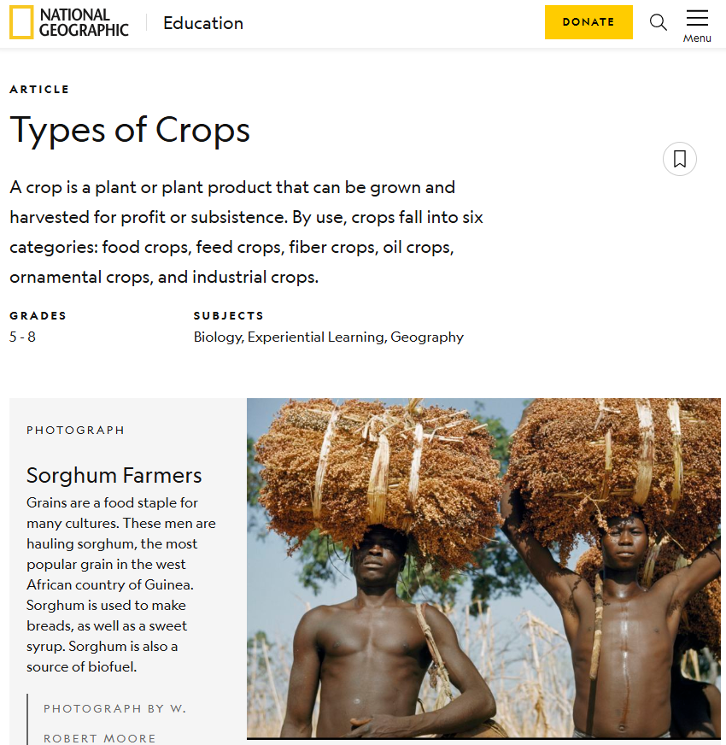
Explore six types of crops using the National Geographic article
https://education.nationalgeographic.org/resource/crop/

Slide 9
Types of Crops
🌾Food crops
Wheat, corn, rice, vegetables
🌽Feed crops
Crops grown to feed animals
👕 Fibre crops
Cotton for clothing or bamboo for paper
🌻 Oil crops
Wheat, corn, rice, vegetables
🌸 Ornamental crops
Flowers for decoration or trees for Christmas
⚙️ Industrial crops
Biofuels, rubber
Which crop types use the most land, and why?

Slide 10
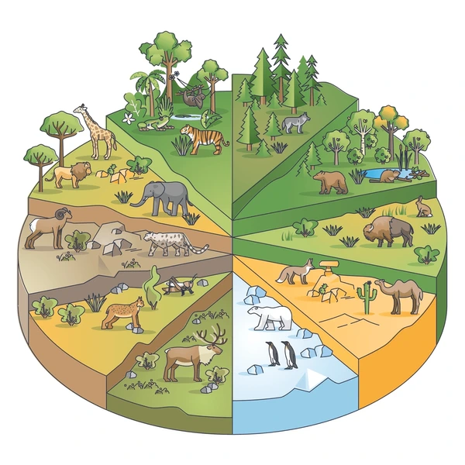
Section C: Biodiversity – Why It Matters
What is Biodiversity?
Biodiversity means the variety of species, habitats, and ecosystems. All living things are interconnected.
Key Terms:
Habitat - Where organisms live
Species - Different types of organisms
Ecosystem - Living and non-living things interacting
Interdependence - How organisms rely on each other

Slide 11
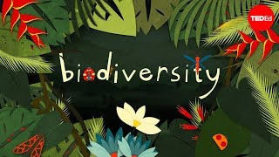

Slide 12
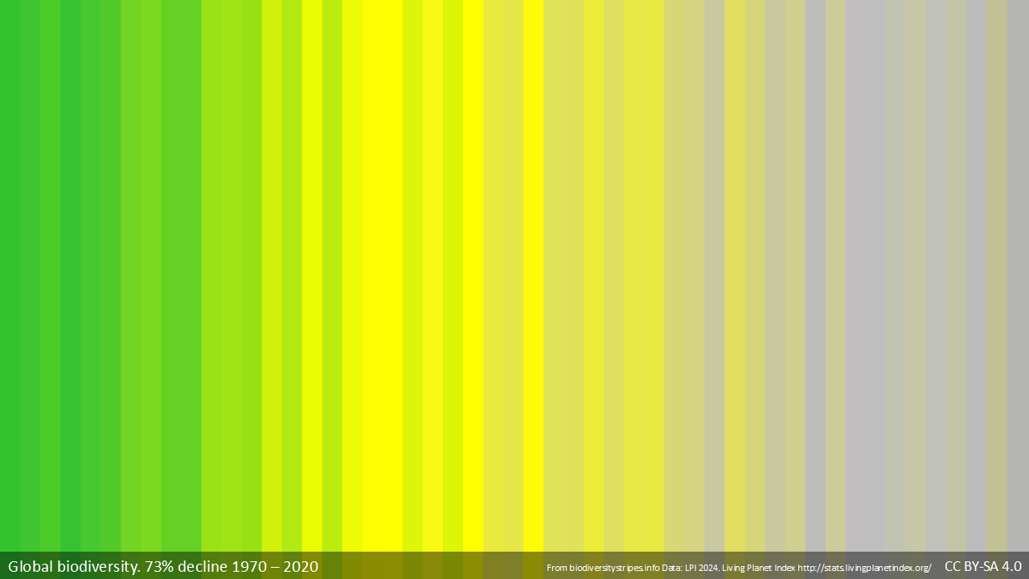
There is a Global biodiversity crisis. In the UK there has been a 65% decline in priority species between 1970 and 2019. These stripes represent individual years and show how dramatically biodiversity is decreasing over the past 50 years.
Why does this matter?
• Loss of pollinators affects food production
• Ecosystems become less resilient
• Species extinction is accelerating

Slide 13
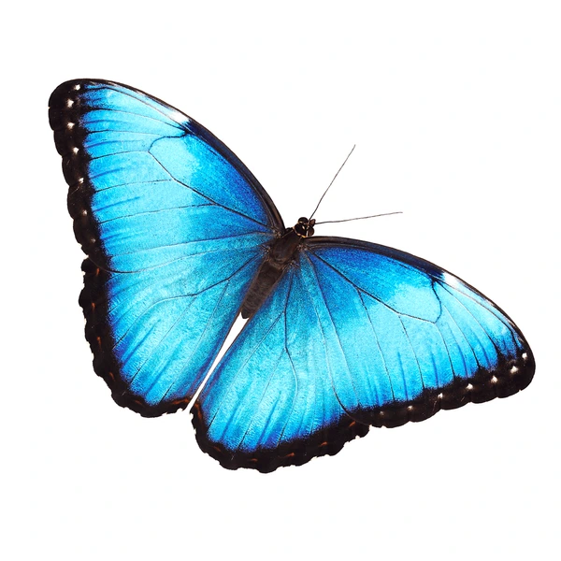
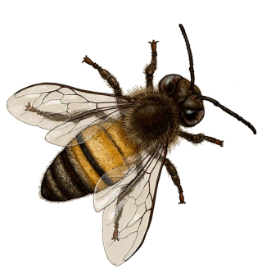
How Pollinators Support Food Production
75% of food crops depend on pollinators for reproduction
1/3 of food we eat relies on pollination
£690 million in value to UK economy annually
Without pollinators like bees, butterflies, and other insects, many crops will fail and food security will be at risk.

Slide 14
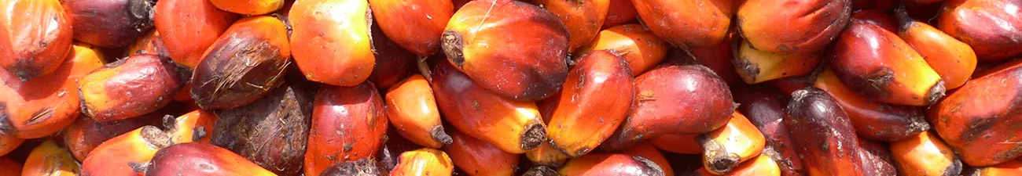
Section D: Agriculture and Habitat Loss
Farming needs land to grow crops and raise animals
Natural habitats (forests, grasslands) are often cleared
This leads to habitat loss and species decline
Biodiversity decreases as ecosystems are destroyed
Have you heard of Palm Oil? Do you know anything that contains it?

Slide 15
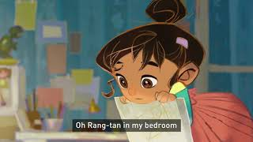

Slide 16
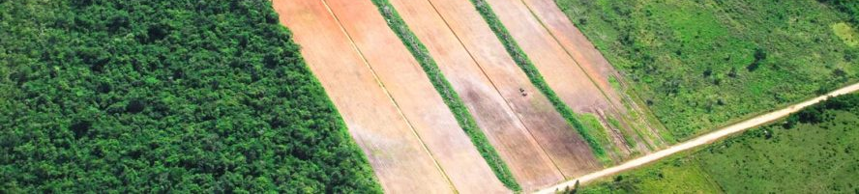
Agricultural Expansion is a Global Issue
Deforestation
Forests cleared for farmland, releasing stored carbon and destroying habitats
Reduced Biodiversity
Wildlife populations decline as natural habitats disappear
Increased Greenhouse Gases
Agriculture contributes significantly to methane and CO₂ emissions

Slide 17
Comparing Farming Systems
Animal Farming
Large land use (for animals + feed crops)
Habitat destruction for grazing and feed
Higher greenhouse gas emissions (methane)
More water use per calorie produced
Greater biodiversity loss
Crop Farming for Humans
Less land per calorie produced
Fewer steps in the food chain
Lower greenhouse gas emissions
More efficient use of resources
Potential for habitat restoration
77% of land is used for growing feed for livestock but provides only 18% of calories consumed

Slide 18
Exit Question
Would moving away from intensive animal farming towards growing more crops for people to eat help protect biodiversity and reduce climate change?
Why or why not? Try to give both sides.
In your answer, try to use the following keywords:
Soil
Crops
Biodiversity
Habitat Loss

Slide 19
Extension / Homework
Option 1 - Video Review
Watch one of the recommended videos and write a short review.
🎥 Sir David Attenborough – Why Is Biodiversity Important?
🎥 Greenpeace – There’s a Monster in My Kitchen
🎥 Is Meat Really That Bad? (10:13)
🎥 Vega the Cow – Climate Healers
Option 2 - Research deforestation in the Amazon
rainforest. Identify causes, consequences and solutions.

