Slide 1


HOW SHOULD WE FARM FOR A BETTER WORLD?
Lesson 2 - Selective Breeding and
Food Chains

Slide 2
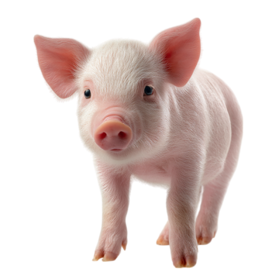
Learning Objectives
By the end of this lesson, you will be able to:
Explain what selective breeding is and why it is used
Describe advantages and disadvantages of selective breeding in farmed animals
Understand basic food chains and energy transfer
Explain how farmed animals fit into human food chains
Evaluate whether animal farming is an efficient and ethical food system

Slide 3

Starter Activity: Think & Pair
Why do farm animals look very different today compared to animals in the wild?
Instructions:
Think: Write down one idea
Pair: Share with a partner
Share: We'll collect ideas as a class
Think about: growth, size, milk production, eggs, meat...

Slide 4
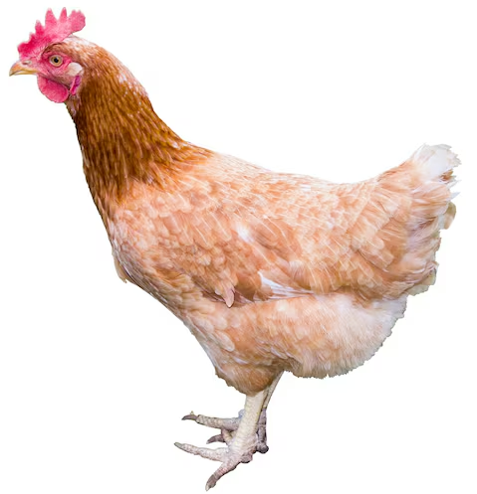
What is Selective Breeding?
Selective breeding is when humans choose animals with certain characteristics to breed together, so their offspring show those traits.
Common Traits Selected:
Growth & Size
Faster growth, larger body size
Body Shape
Specific proportions for meat production
Production
More meat, milk, or eggs
Behaviour
Calm, easy to manage temperament

Slide 5
Video: Overview of Selective Breeding
Trigger Warning: This film contains scenes of animals which may be upsetting.
While watching, note:
One benefit of selective breeding
One problem caused by selective breeding

Slide 6
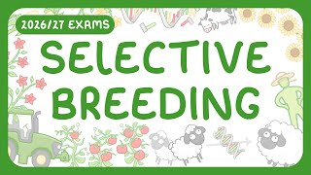

Slide 7

What are the impacts of
Selective Breeding?
Review two case studies from the CIWF video:
  Case Study 1: Chickens
Intensive chicken farming selective breeding
  Case Study 2: Dairy Cows
Intensive dairy farming selective breeding

Slide 8


Slide 9

Impacts of Selective Breeding
Discuss:
Is selective breeding good for animals?
Teacher notes: https://www.ciwf.org.uk/media/5262846/Science-worksheets-compilation-booklet.pdf

Slide 10

Selective Breeding: Pros & Cons
Advantages
More food produced
Cheaper food prices
Predictable animal traits
Can breed for specific needs
Disadvantages
Health problems (weak legs, breathing issues)
Reduced genetic diversity
Animal welfare concerns
Animals bred beyond natural limits
X

Slide 11
Jot notes:
Is selective breeding always harmful, or does it depend on how it is used?
Think about the evidence you've seen today...

Slide 12
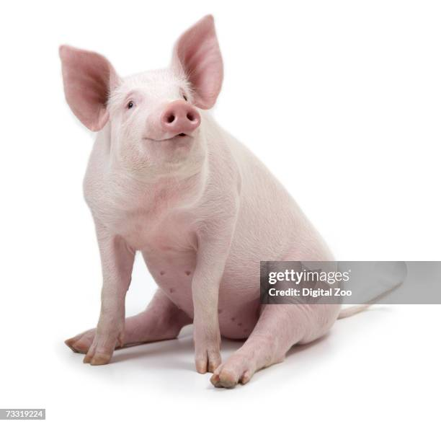
Think, pair, share:
Should animal welfare come at the expense of cheap food?
Consider:
Evidence from the videos
Different perspectives (farmers, consumers, animals)
Real-world challenges and trade-offs
Remember: Listen respectfully to different viewpoints

Slide 13
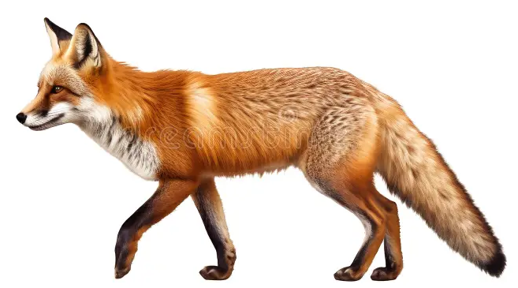
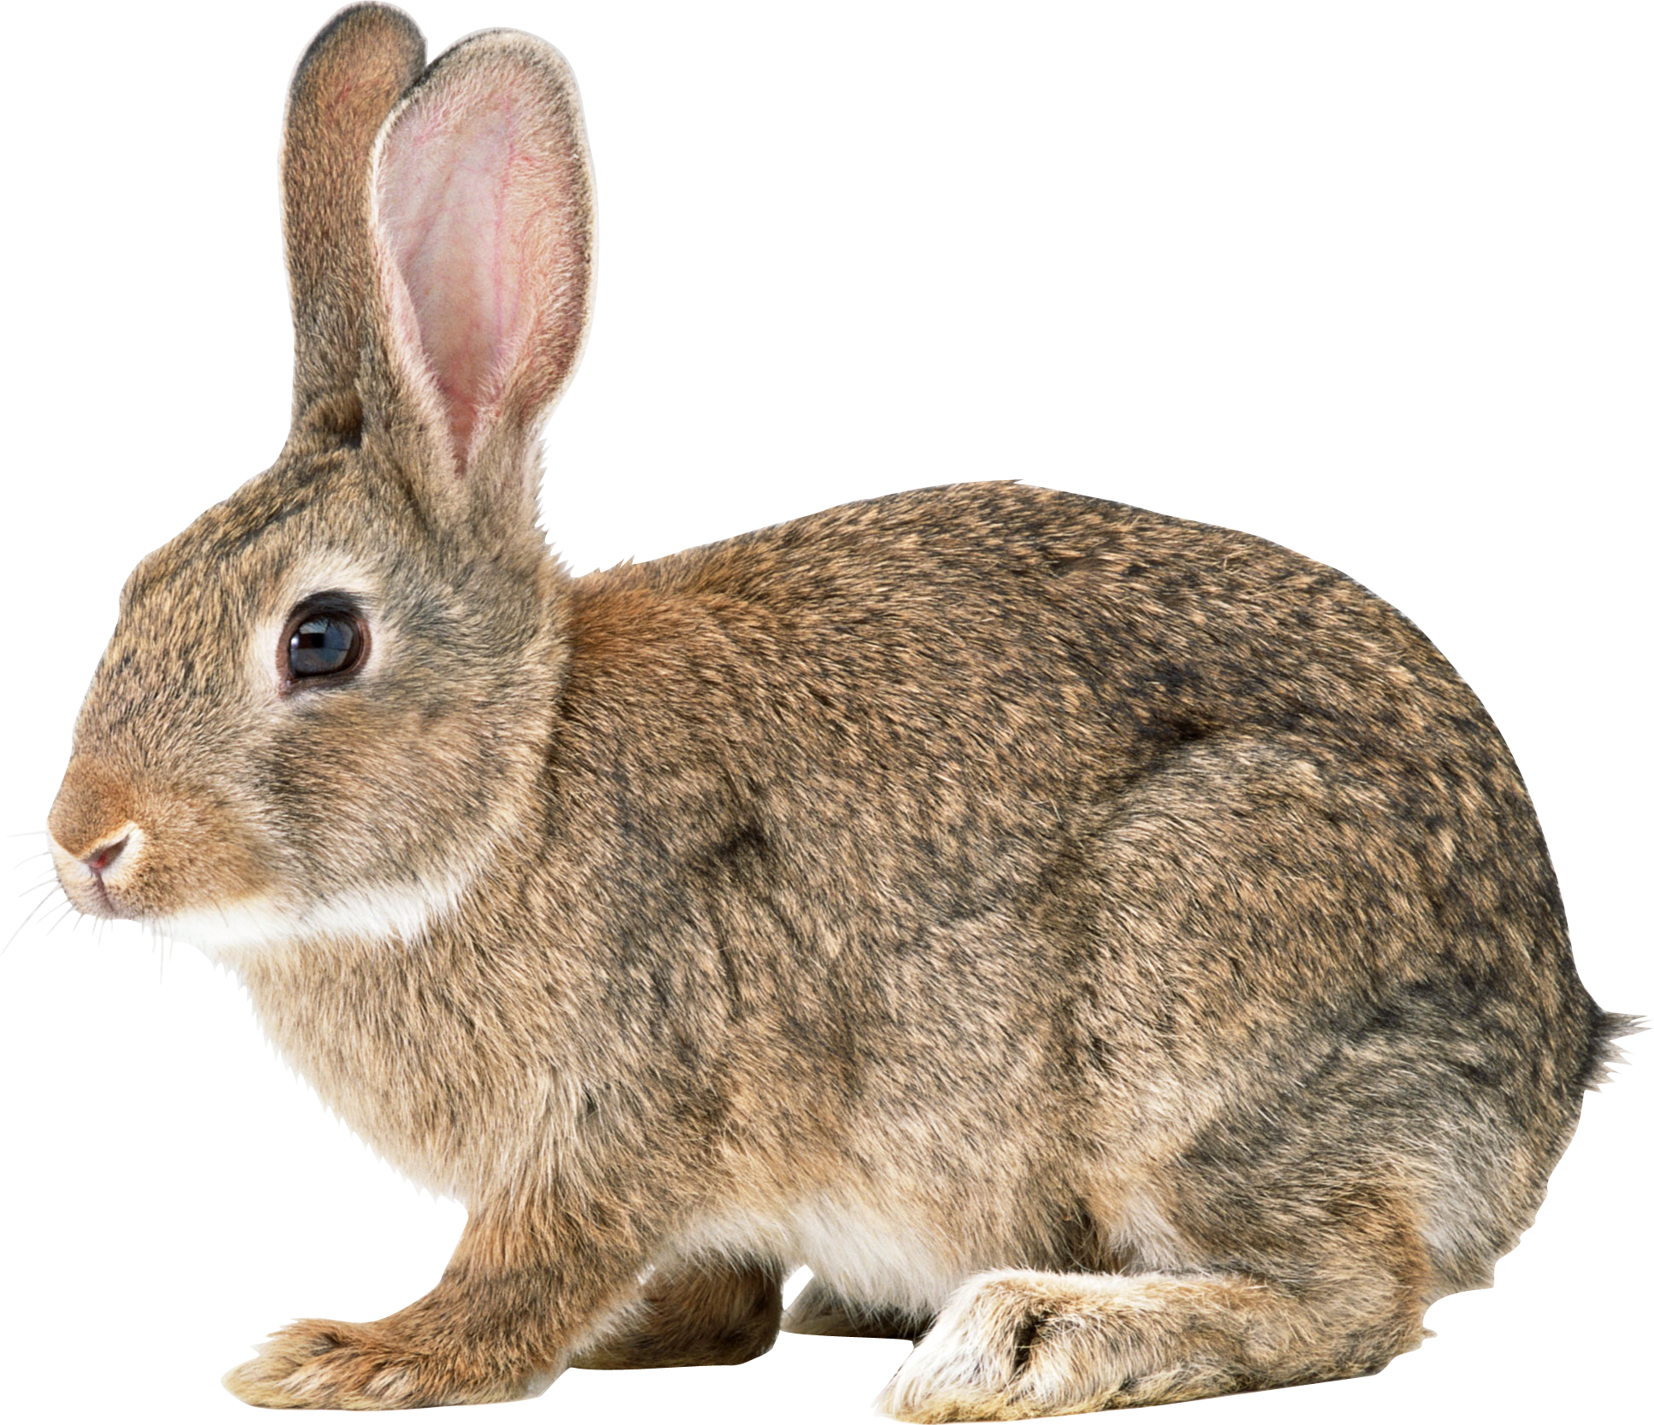
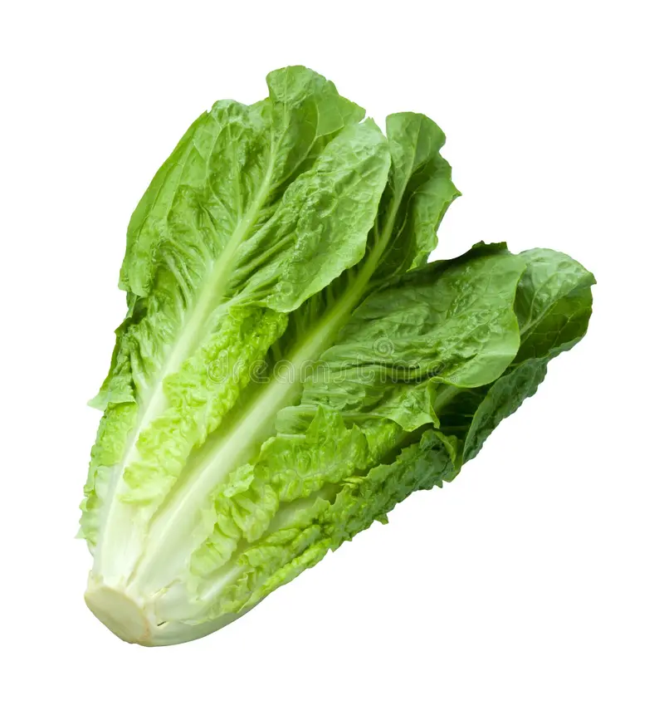
What is a Food Chain?
A food chain shows how energy moves from one living thing to another.
Plants
(Producer)
Herbivore
(Consumer)
Carnivore
(Predator)
Key Terms:
Producer - Plants that make their own food using sunlight
Consumer - Animals that eat plants or other animals
Predator - Animals that hunt other animals
Energy Loss - Energy decreases at each level (the arrows show the direction of energy). At each step, about 90% of energy is lost as heat, movement, and waste.

Slide 14
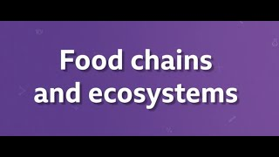
Video: Food Chains
Key Point: Energy decreases at each level of the food chain

Slide 15

Farmed Animals in Food Chains
We'll now watch two more sections from the CIWF video:
Section 1
Food chains & efficient food production (starts at 13:30)
Section 2
Alternative systems & personal choices (starts at 14:45)

Slide 17
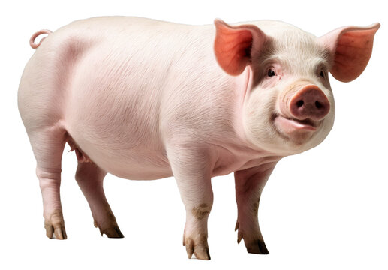
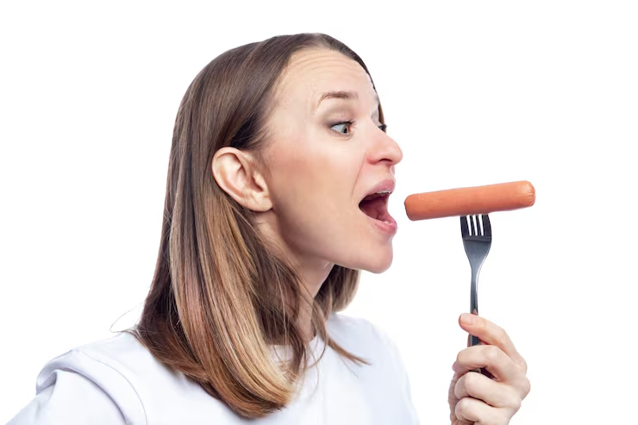
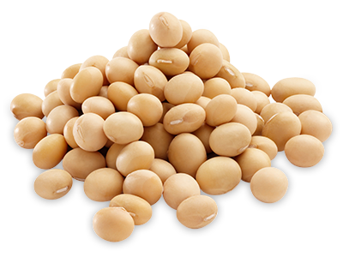
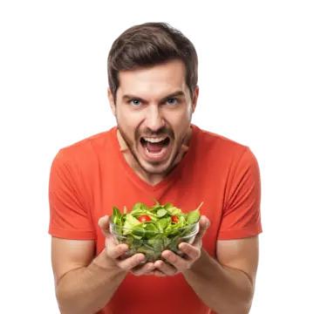
Animal-Based Food Chain:
Plant-Based Food Chain:
Plants
(Producer)
Herbivore
(Primary consumer)
Carnivore
(Secondary consumer)
Plants
(Producer)
Herbivore or omnivore
(Primary consumer)

Slide 18
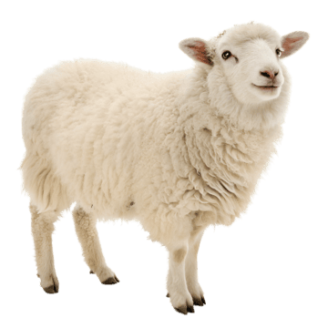
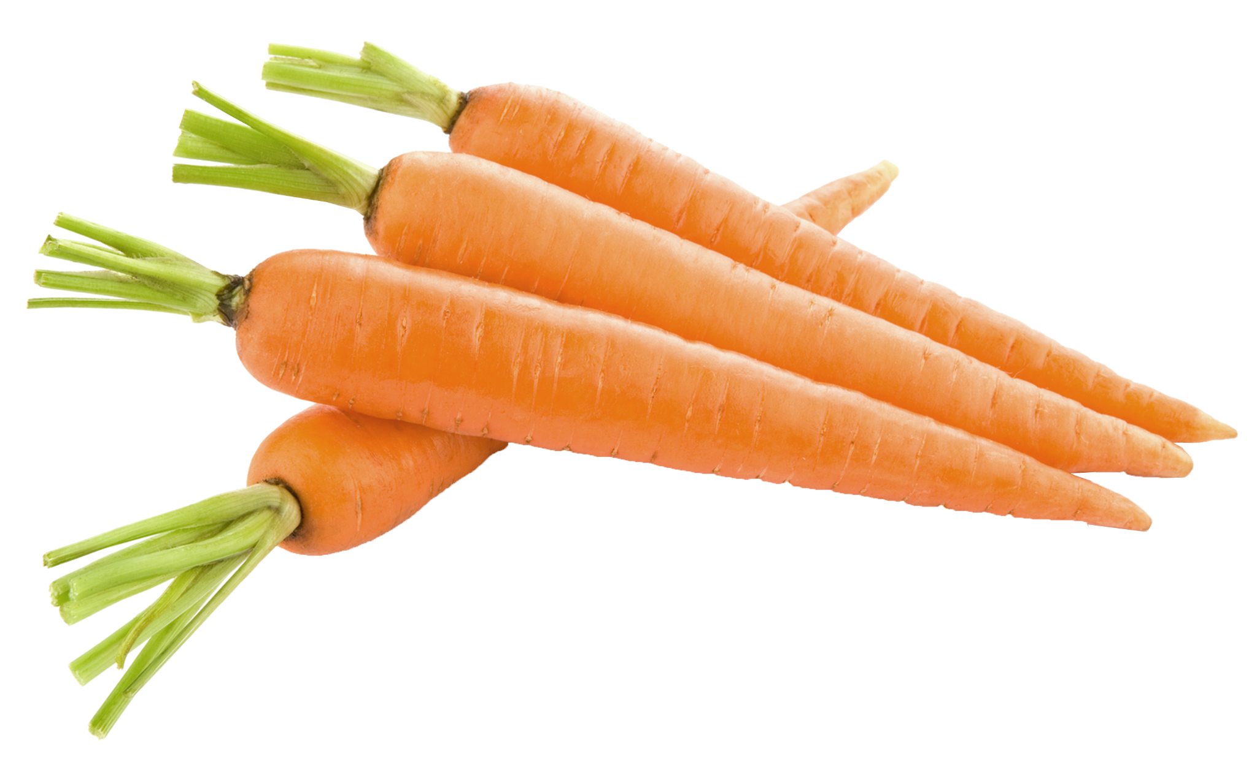
How efficient is the energy transfer in a food chain?
Key Points:
Animals eat plants → humans eat animals
Energy is lost at each step
Feeding crops to animals is less energy-efficient than feeding humans directly
More steps in the food chain = More energy loss

Slide 19
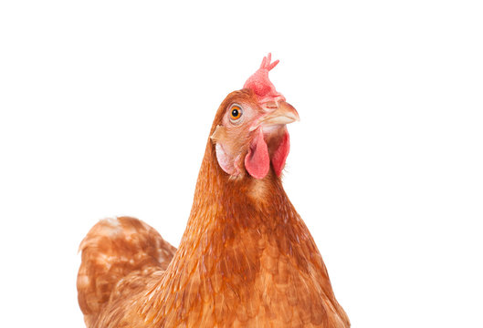
How do food chains compare?
Animal-Based Chain
✗ More energy loss
✗ More land needed
✗ More water needed
✗ More crops needed
Plant-Based Chain
✓ Fewer steps
✓ More energy efficient
✓ Less land use
✓ Less resource use

Slide 20
How do food chains link to wider sustainability issues?
Climate Impact
Food chains with more steps often produce more greenhouse gases
Land Use
Animal farming requires more land for both animals and their feed crops
Global Food Security
Shorter food chains can feed more people with the same amount of crops

Slide 21
Exit Quiz
Question 1
What is selective breeding?
When animals choose their own mates in the wild
When humans choose animals with certain characteristics to breed together
When plants naturally cross-pollinate
When scientists change DNA in a laboratory

Slide 22
Question 2
Which of these traits are commonly selected for in farm animals through selective breeding?
Faster growth, more milk, and larger body size
Ability to survive in the wild
Bright colours and patterns
Longer lifespans

Slide 23
Question 3
Which of these is a disadvantage of selective breeding in farmed animals?
Animals produce more food
Health problems such as weak legs and breathing issues
Food becomes more expensive
Animals become unpredictable

Slide 24
Question 4
What is a producer in a food chain?
An animal that hunts other animals
A plant that makes its own food using sunlight
An animal that eats plants
A decomposer that breaks down waste

Slide 25
Question 5
In a food chain, what do the arrows represent?
The direction animals move
The direction of energy transfer
The size of organisms
The direction of energy transfer

Slide 26
Question 6
Approximately how much energy is lost at each step of a food chain?
About 10%
About 25%
About 50%
About 90%

Slide 27
Question 7
Compare these two food chains:
Chain A: Plants → Cow → Human
Chain B: Plants → Human
Which statement is correct?
Chain A is more energy efficient
Chain B is more energy efficient because it has fewer steps
Both chains are equally efficient
Chain A uses less land and resources

Slide 28
Question 8
Which advantage of selective breeding was mentioned in the lesson?
More food produced and cheaper food prices
Improved animal welfare
Increased genetic diversity
Animals living longer lives

Slide 29
Question 9
Why is feeding crops to animals and then eating the animals less energy-efficient than eating plants directly?
Animals don't like crops
Plants contain more energy than animals
Energy is lost at each step of the food chain
Animals don't digest food properly

Slide 30
Question 10
How does animal farming relate to sustainability issues?
Animal farming has no environmental impact
Animal farming requires more land, water, and crops, and often produces more greenhouse gases
Animal farming uses less land than plant farming
Animal farming prevents climate change

Slide 31
Quiz answers:
B
A
B
B
D
D
B
A
C
B

Slide 32
Extension / Homework
Option A: Selective Breeding - BBC Bitesize KS3 – Species & Selective Breeding:
Includes short quiz and revision tasks
Option B: Big Picture Thinking - Videos to explore:
TED-Ed: "What Would Happen If Everyone Stopped Eating Meat Tomorrow?" (4:36)
Animal Aid: "From Farm to Fork" (11:00)
Task: List one challenge, one benefit, and one unanswered question
Option C: Essay - Would a move away from animal farming to farming crops for humans to eat make for a more energy-efficient human food chain? Why?
In your answer, use:
Food chain vocabulary (producer, consumer, energy loss)
Evidence from the videos
Scientific reasoning

