Slide 1


HOW SHOULD WE FARM FOR A BETTER WORLD?
Lesson 1 - What Does Farming Look Like?

Slide 2
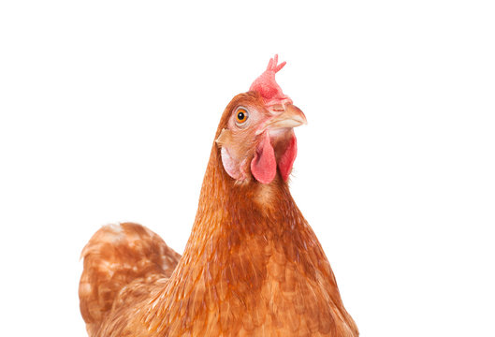
Learning Objectives
By the end of this lesson, you will be able to:
Describe common perceptions and realities of farming
Identify different types and systems of farming
Explain what animal sentience means
Describe how intensive farming systems affect farmed animals
Evaluate different viewpoints on how farmed animals should be treated

Slide 3

What Does a Farm Look Like?
Task: Sketch a farm, or list what you imagine is on one (3 minutes)
Think about:
Buildings
Landscape features
Equipment
Animals and where they are

Slide 4
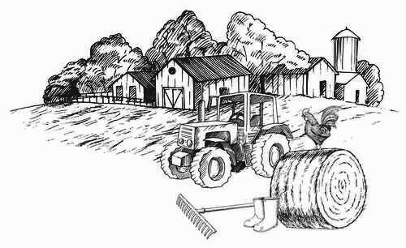
Did you draw something like this?

Slide 5
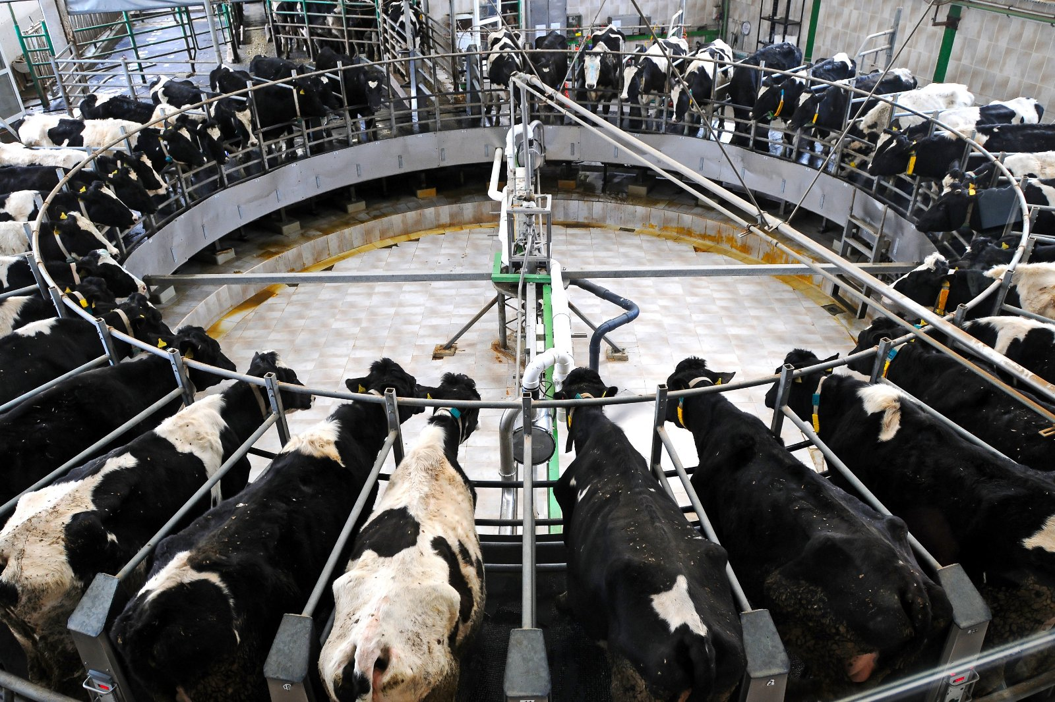
In the UK in 2026 this is a dairy farm….

Slide 6
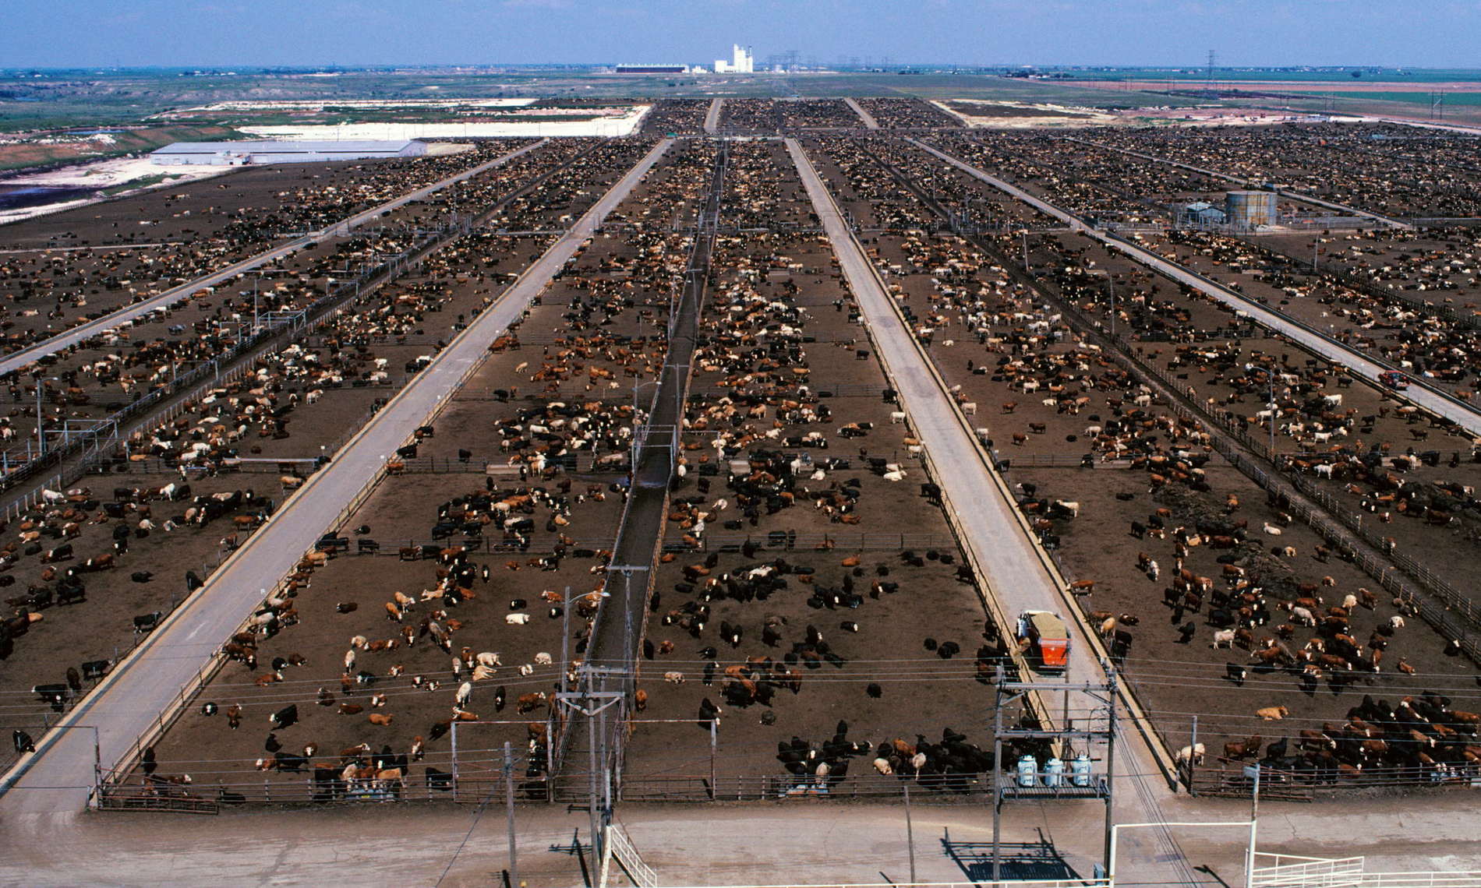
In the USA in 2026 this is a cattle megafarm….

Slide 7
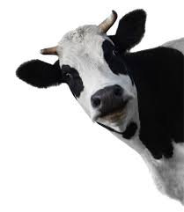
What is Animal Sentience?
Do you think farmed animals can feel pain, happiness, or form bonds?
What is Sentience?
Sentience means the ability to feel:
  Pain and discomfort
  Pleasure and happiness
  Fear and anxiety
  Comfort and contentment

Slide 8
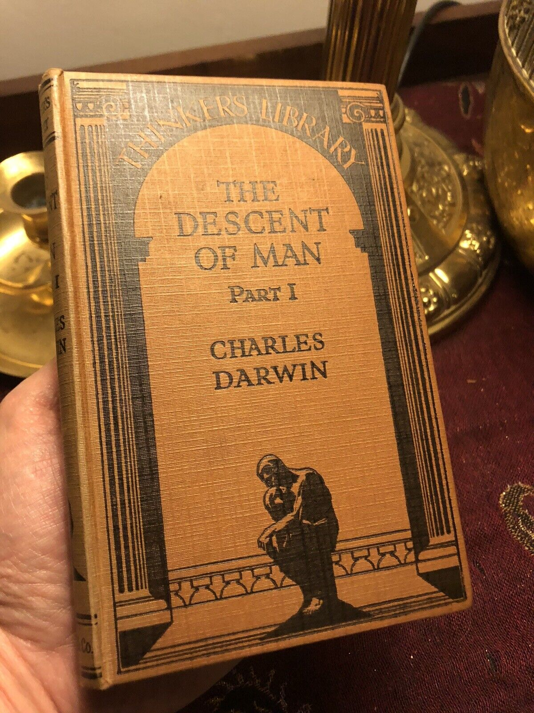
“… animals, like man, manifestly feel pleasure and pain, happiness, and misery.”
Charles Darwin,
The Descent of Man (1871)

Slide 9
What are the different types of farming?
🐄 Animal Farming
Animals raised for food or products
🌾 Arable Farming
Crops only
🚜 Mixed Farming
Combination of crops and animals
🐟 Aquaculture
Farming fish and aquatic animals

Slide 10
How do farming systems and methods compare?
More Intensive / Industrial
Large scale operations
High animal numbers
Technology and chemicals used to maximise output
These farming systems have different impacts on:
🐄 Animals
👥 People
🌍 Environment
More Extensive / Ecological
Organic farming
Vegan organic systems
Regenerative agriculture
Agroforestry and permaculture
Modern & Tech-Driven
Precision agriculture (data and sensors)
Hydroponics and vertical farming

Slide 11
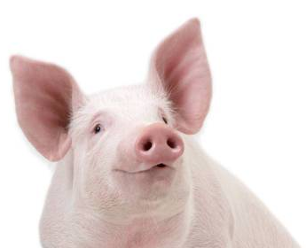
What is Factory Farming?
Factory farming, megafarms or intensive farms are modern systems using highly intensive methods
Common Features:
Animals often confined in small cages or crates
Large numbers of animals in small spaces (high stocking density)
Focus on maximising production
Stats on Factory Farming in the UK:
1,824 intensive farms in the UK (2023)
1 billion+ animals raised in factory farms every year
85% of all UK farmed animals

Slide 12
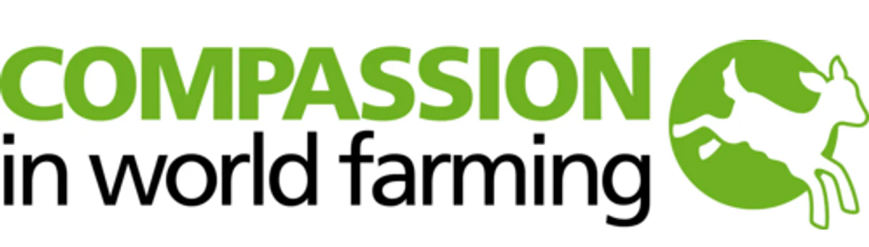
Film: Farm Animals and Us
Trigger Warning: This film contains scenes of animals which may be upsetting.
While watching, note:
One way animals are affected by farming systems
One benefit mentioned by farmers or society
One concern raised about animal welfare

Slide 13
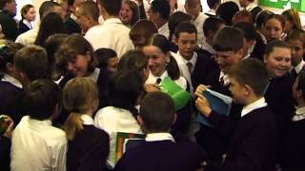

Slide 14

Debate Activity
How Should We Treat Farmed Animals?
Consider:
🐄 Animal welfare
💰 Food prices
📊 Efficiency
⚖️ Ethics
🌍 Environmental impact
Use the CIWF Activity Cards

Slide 15
Are there pros and cons to the different systems?
Intensive Systems
✓ Produce large amounts of food
✓ Lower retail prices
✗ Animal welfare trade-offs
✗ Often harmful to environment
✗ Hidden costs (subsidies, environmental damage, job losses)
Less Intensive Systems
✓ Higher welfare potential
✓ Often reduce environmental harm
✗ Often higher costs
Note: Historically subsidised less than factory farming
There are trade-offs in farming choices. Every decision has consequences for animals, people, and the planet.

Slide 16
Exit Question
Should food production prioritise low cost, animal welfare, or environmental protection – or a balance of all three?
In your answer, try to use:
The concept of sentience
Examples of farming systems
Evidence from the video

Slide 17
Extension / Homework
Option 1: Research Task
Research one animal farming system and list:
One benefit
One challenge
Option 2: Written Response
Write a paragraph answering:
"Is intensive farming necessary in today's world?"

